Slide 1
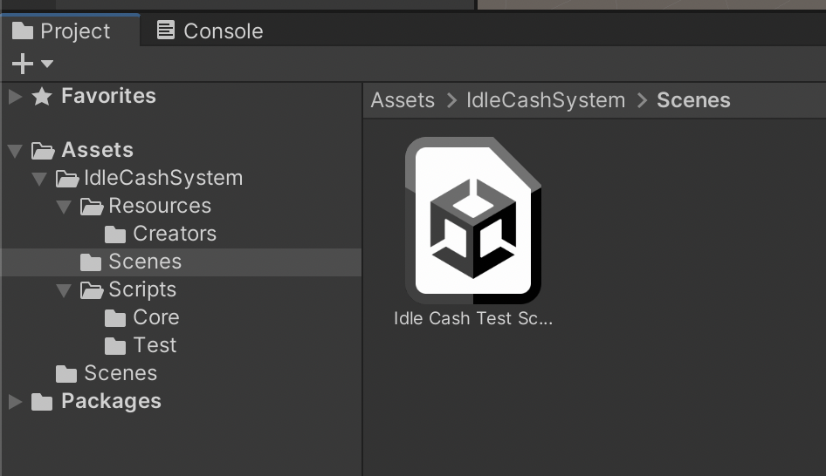
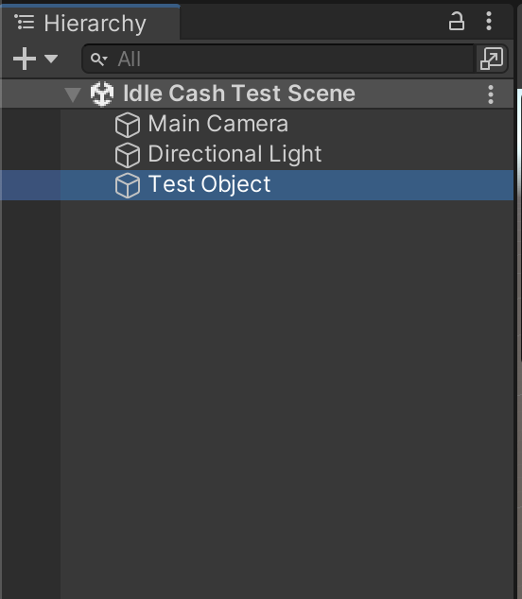
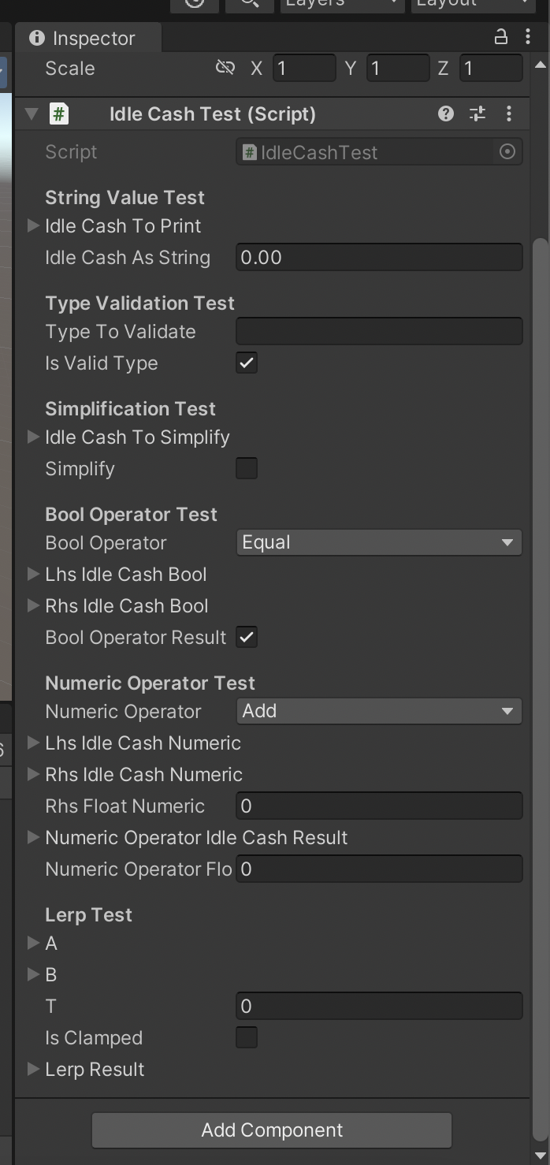
Test Scene
Path: IdleCashSystem/Scenes/
Select the Test Object
From the Hierarcy

Slide 2
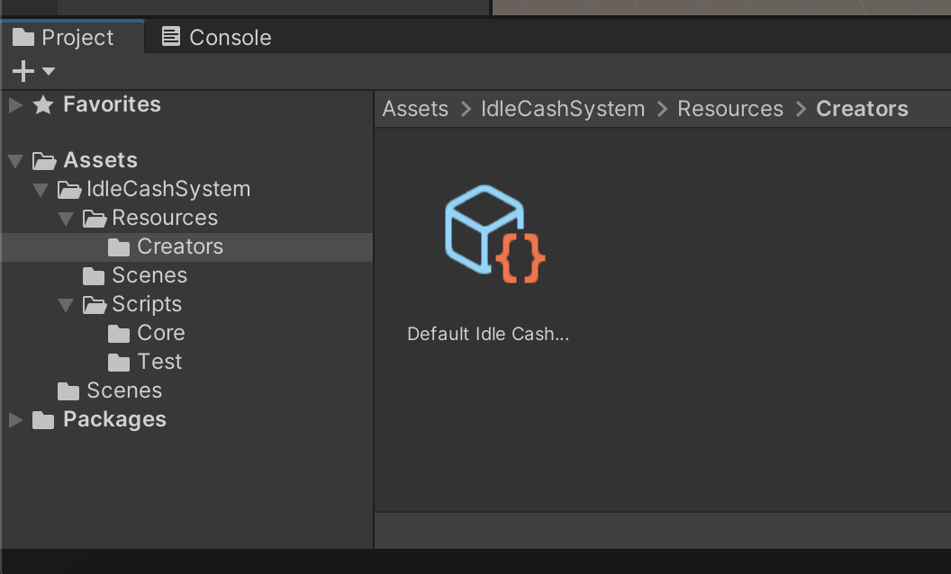
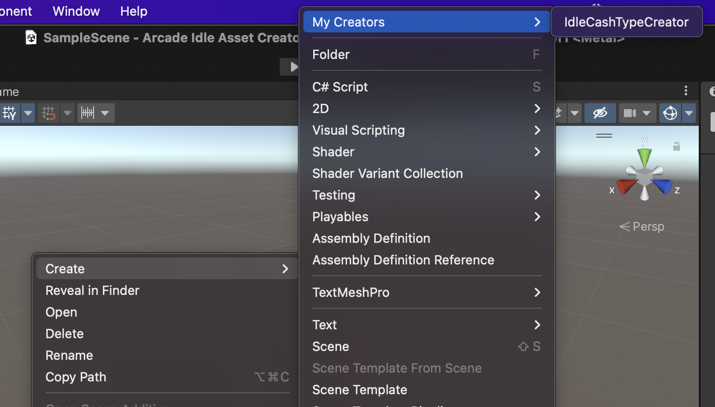
IdleCashTypeCreator
Default Settings path:
IdleCashSystem/Resources/Creators/
If you delete it somehow, Create it again from Create/My Creators/IdleCashTypeCreator

Slide 3
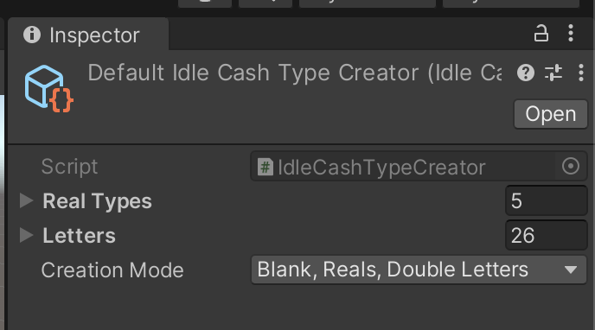
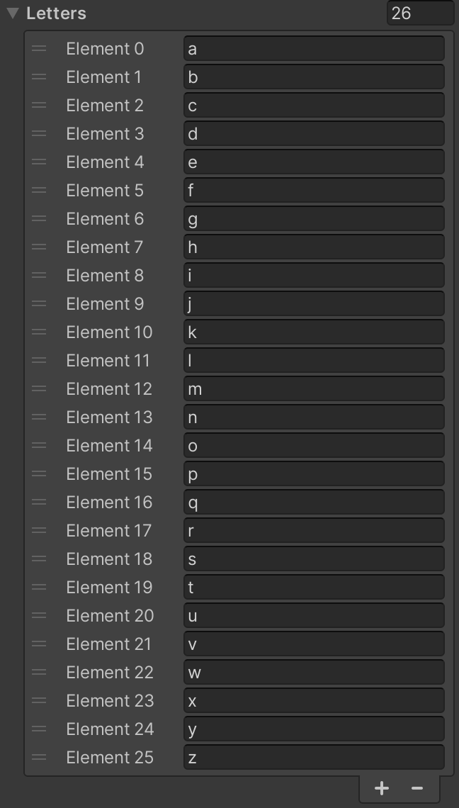
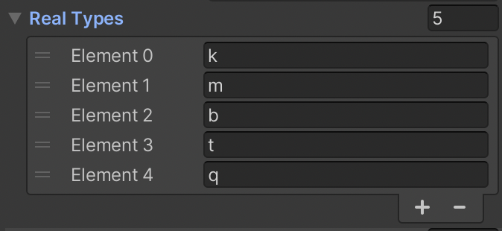
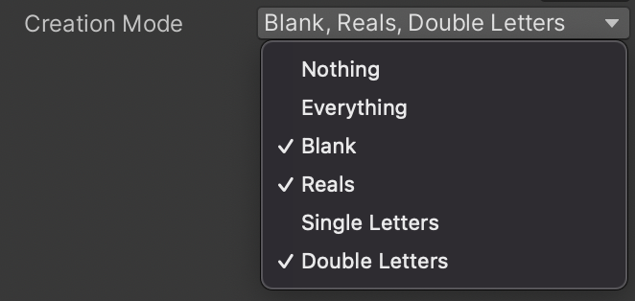
IdleCashTypeCreator
Default Settings

Slide 4
IdleCashTypeCreator
Blank Type
Real Types
Comes after the Blank Type and befor the Letter Types
Letters
Comes after the Real Types can be Single and Double
Creation Mode
Toggles Type Variants

Slide 5
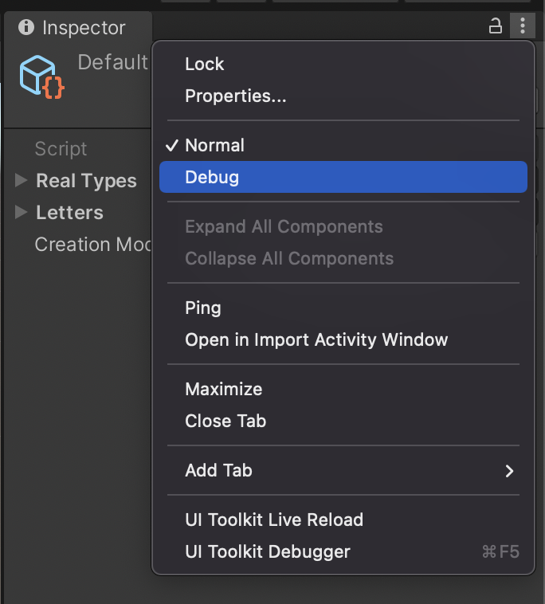
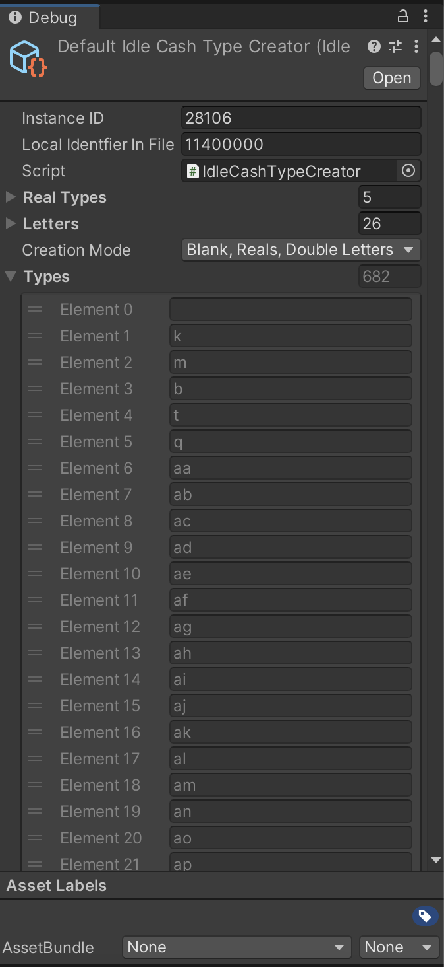
IdleCashTypeCreator
Select Debug for Debugging the Created Types

Slide 6
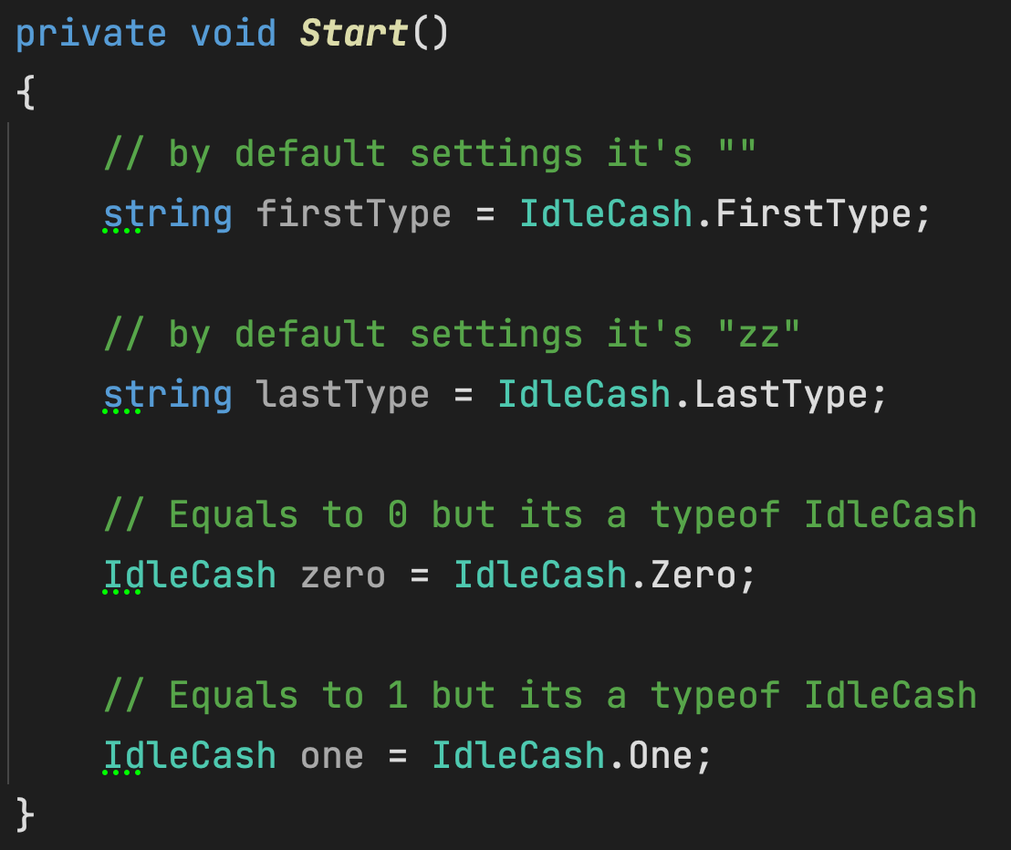
Static Properties
IdleCash
First Type | Returns the First Type from IdleCashTypeCreator
Last Type | Returns the Last Type from IdleCashTypeCreator
Zero | Shorthand for new IdleCash(0f, FirstType)
One | Shorthand for new IdleCash(1f, FirstType)

Slide 7
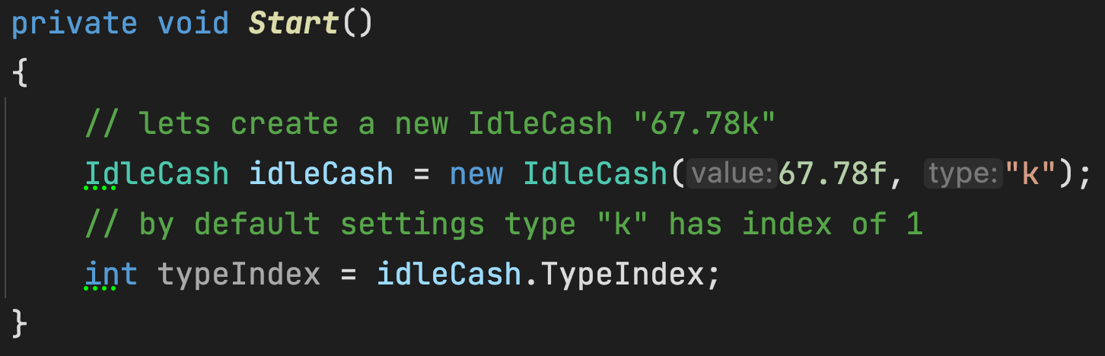
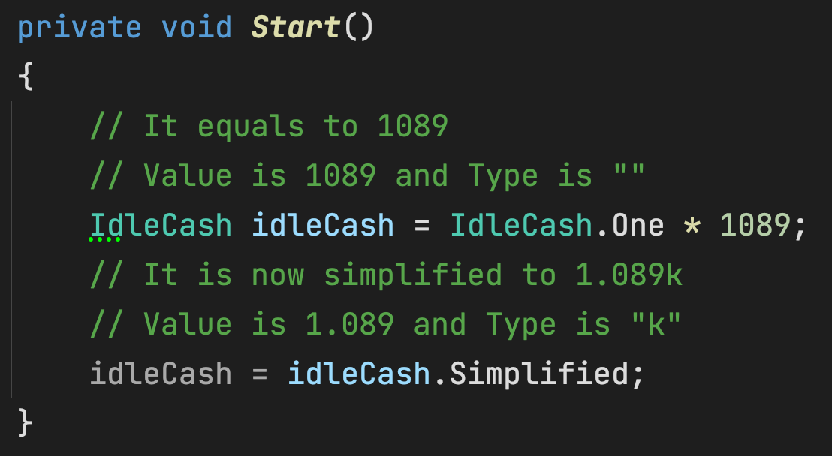
Properties
IdleCash
TypeIndex | Returns the Current Type’s Index
Simplified | Returns the Simplified form

Slide 8
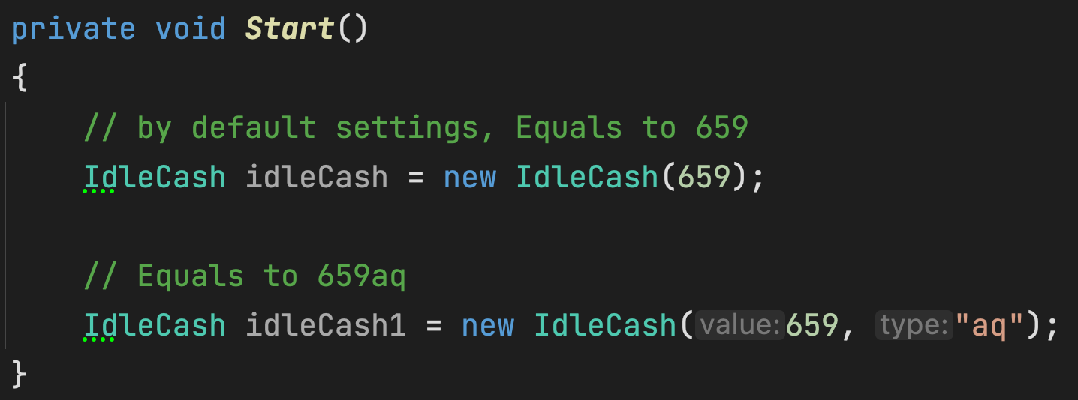
Constructors
IdleCash

Slide 9
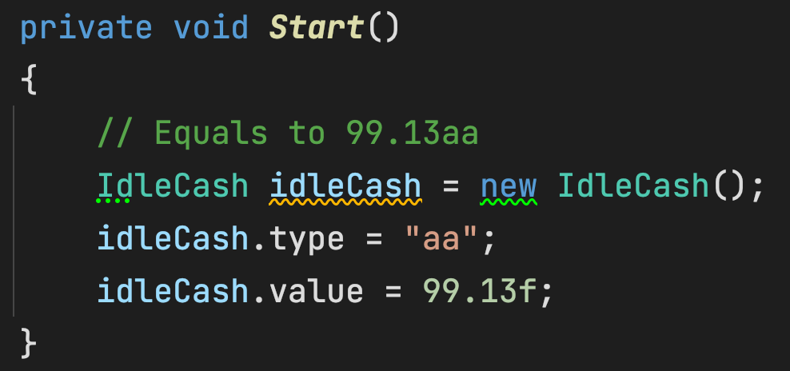
Public Fields
IdleCash
type | The Type Field of the IdleCash
value | The Value Field of the IdleCash

Slide 10
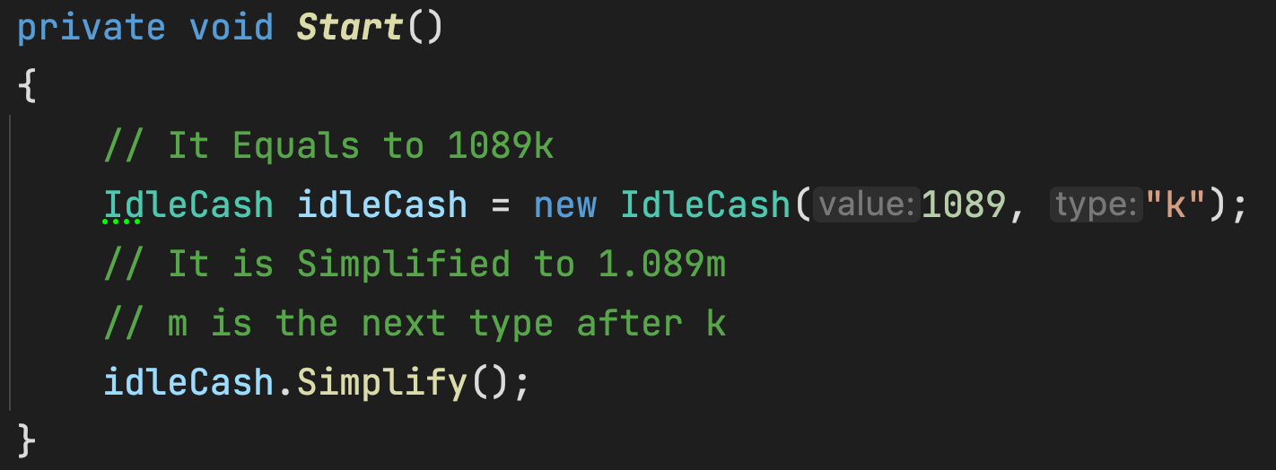
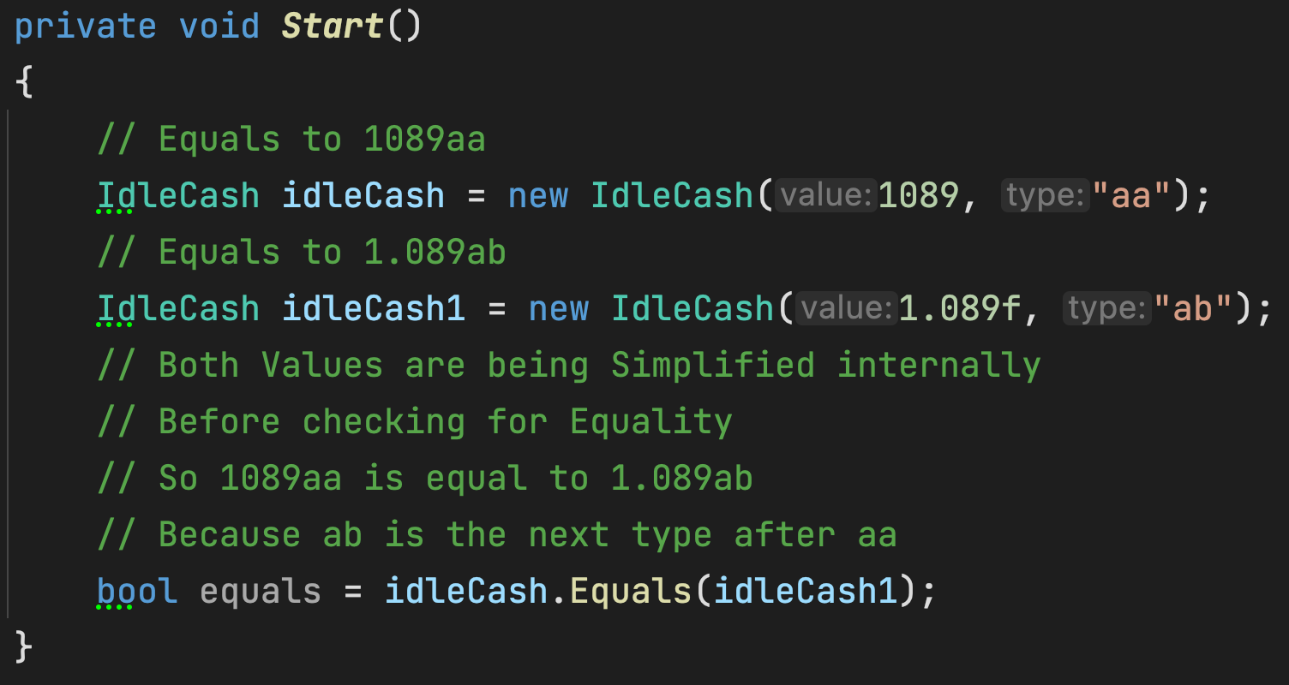
Public Methods
IdleCash
Simplify | Simplifies the IdleCash
Equals | Returns true if both IdleCash are Equal
ToString | Returns the string format

Slide 11
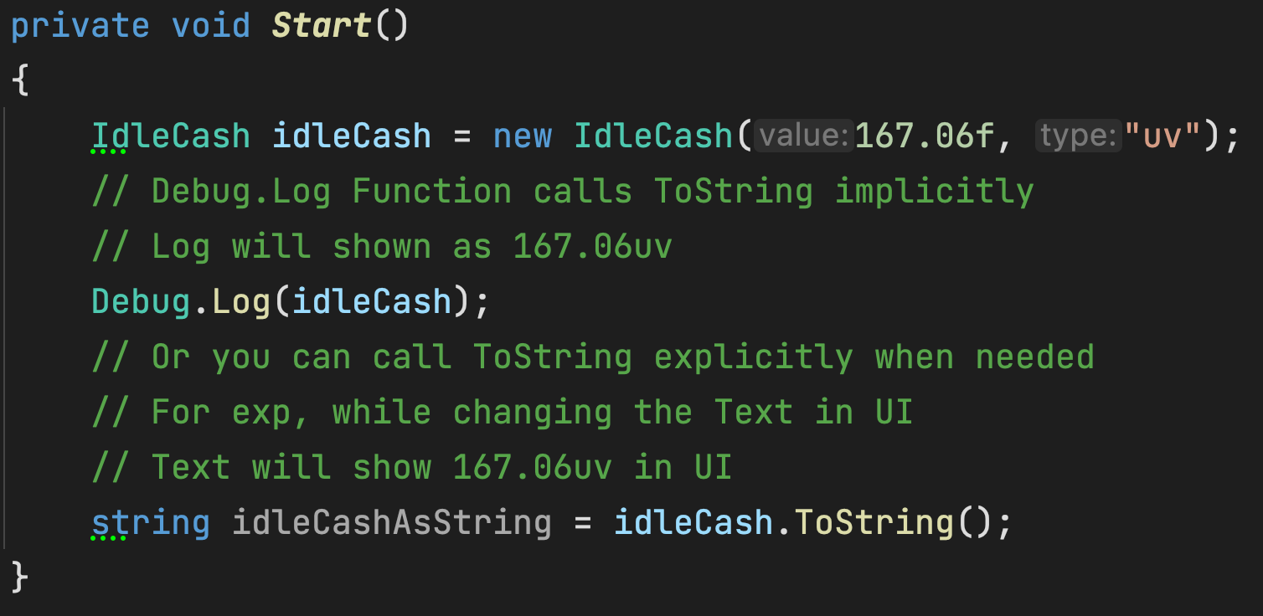
IdleCash

Slide 12
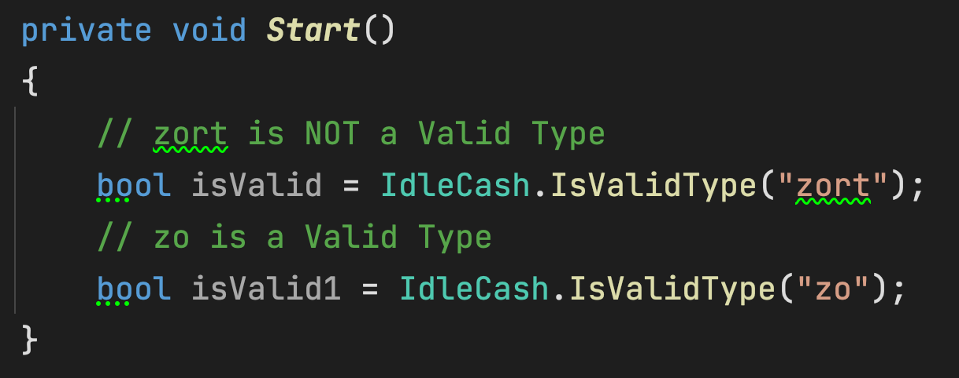
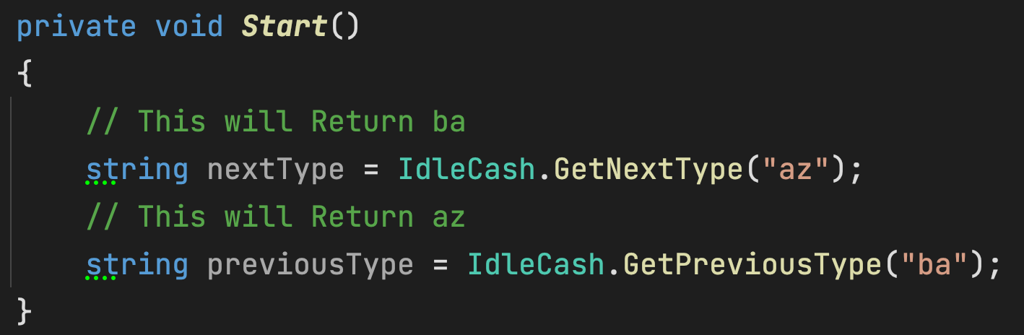
Static Methods
IdleCash
IsValidType | Checks if the Given Type is a Valid Type
GetNextType | Returns the Next Type after the Given Type
GetPreviousType | Returns the Previous Type before the Given Type
Lerp | Lerps between two IdleCash (t is clamped [0f, 1f])
LerpUnclamped | Lerps between two Idle Cash (no clamping)

Slide 13
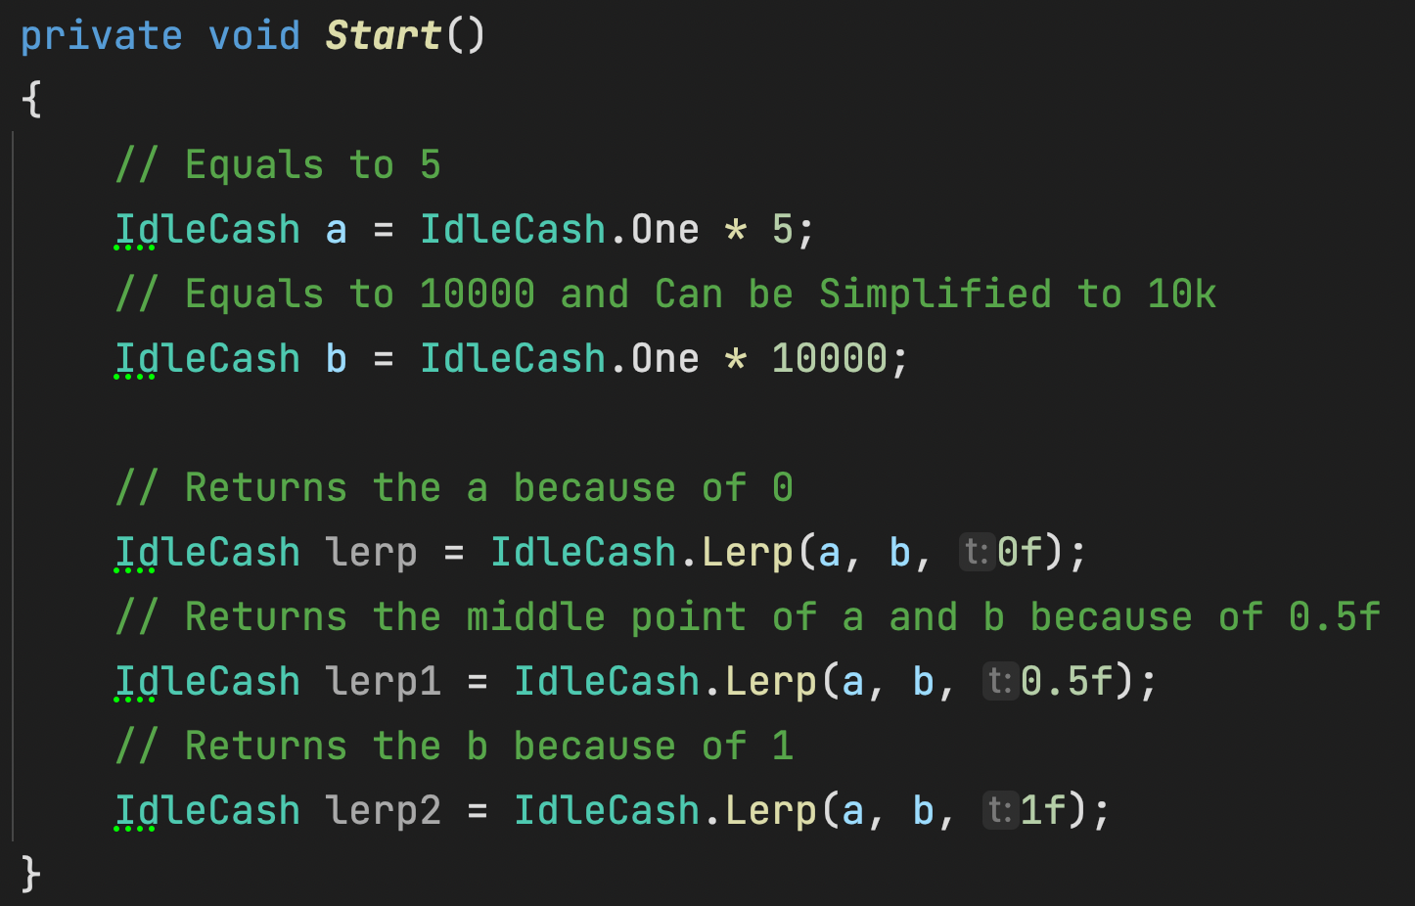
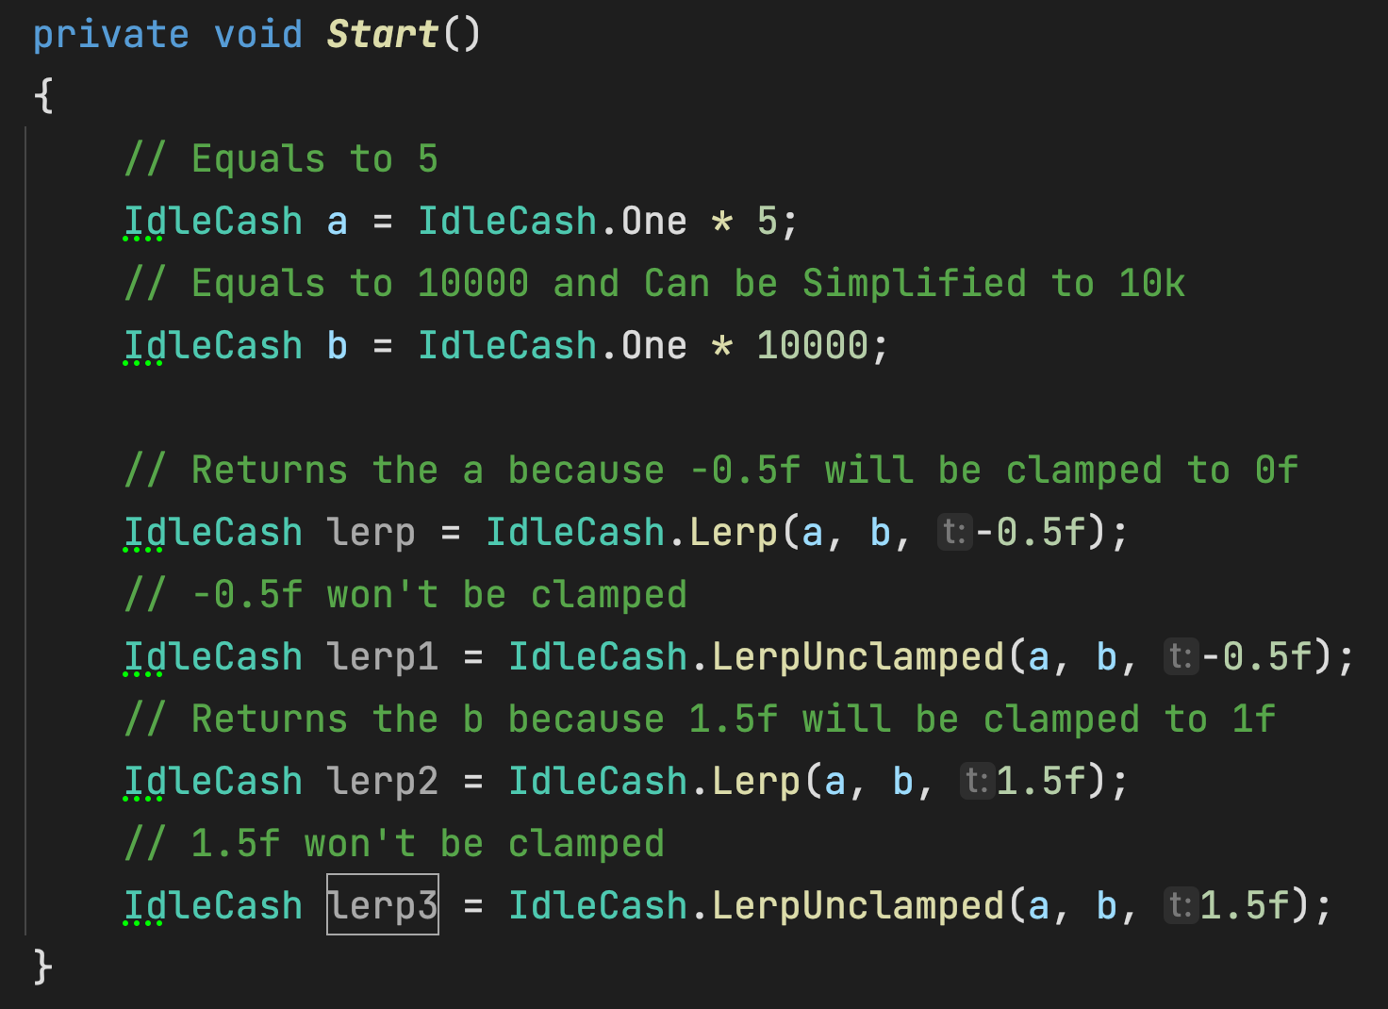
IdleCash

Slide 14
Operators
IdleCash
** All IdleCash Results will be Auto Simplified **
Operator (+) | Add two IdleCash together
Operator (-) | Subtracts IdleCash from other IdleCash
Operator (*) | Multiplies IdleCash with a Float
Operator (/) | Divides IdleCash by a Float
Operator (/) | Divides IdleCash by a IdleCash
Operator (==) | Equality Check between two IdleCash
Operator (!=) | Not Equal Check between two IdleCash
Operator (<) | Smaller Check for between IdleCash
Operator (>) | Larger Check for between IdleCash
Operator (<=) | Smaller or Equal Check between two Idle Cash
Operator (>=) | Larger or Equal Check between two Idle Cash

Slide 15
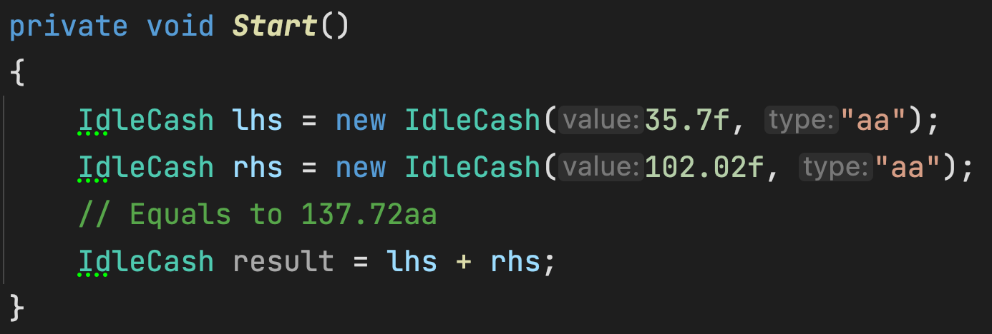
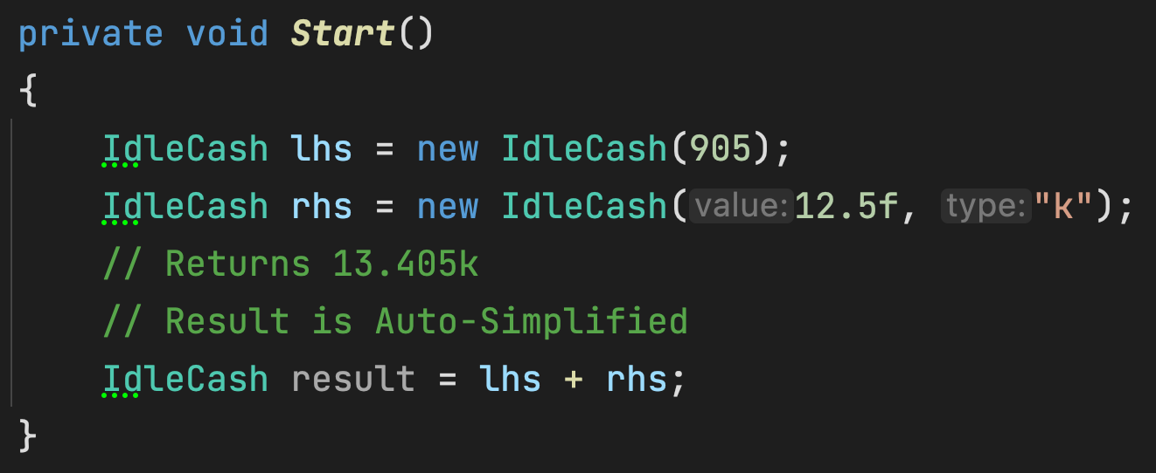
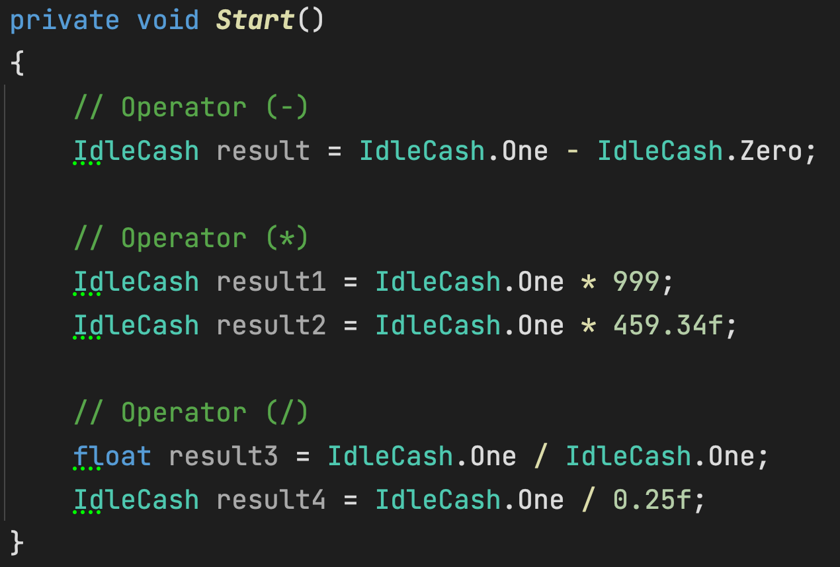
IdleCash

Slide 16
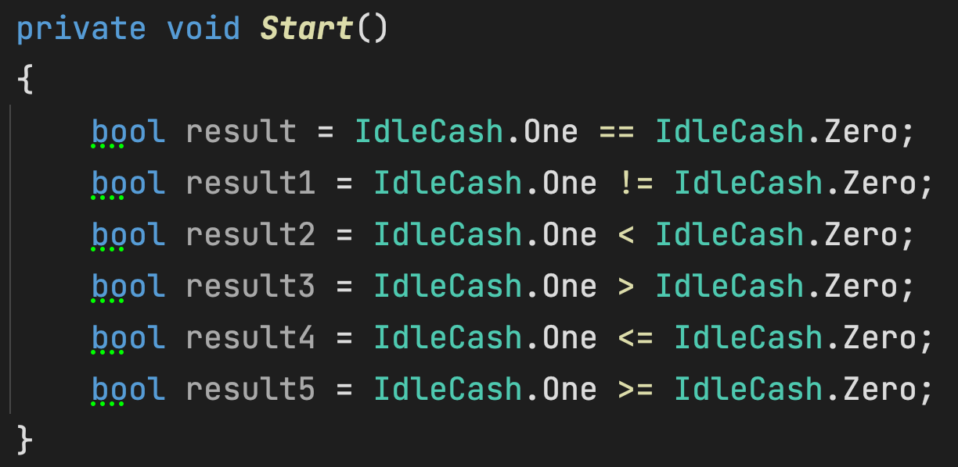
IdleCash

